Slide 1
Hotel booking analysis
CAPSTONE PROJECT
Presented By:
1. M.KARTHIKEYAN - Jayaraj Annapackiam C.S.I College of Engineering-B.E Mechanical Engineering

Slide 2
OUTLINE
Problem Statement
Proposed System/Solution
System Development Approach
Algorithm & Deployment
Result
Conclusion
Future Scope
References

Slide 3
Problem Statement
Have you ever wondered when the best time of year to book a hotel room is? Or the optimal length of stay in order to get the best daily rate? What if you wanted to predict whether or not a hotel was likely to receive a disproportionately high number of special requests? This hotel booking dataset can help you explore those questions! This data set contains booking information for a city hotel and a resort hotel, and includes information such as when the booking was made, length of stay, the number of adults, children, and/or babies, and the number of available parking spaces, among other things. All personally identifying information has been removed from the data. Explore and analyse the data to discover important factors that govern the bookings.
In the hospitality industry, optimizing hotel bookings is crucial for maximizing revenue and ensuring customer satisfaction. Hotel managers need to understand booking patterns, identify trends, and make data-driven decisions to improve occupancy rates and profitability. The goal of this analysis is to analyze historical booking data and derive actionable insights to enhance booking strategies and operational efficiency.

Slide 4
Proposed Solution
Data Collection and Cleaning
Exploratory Data Analysis (EDA)
Demand Forecasting
Customer Segmentation
Cancellation Analysis
Optimization Strategies
Performance Evaluation
Recommendations and Action Plan
By following this proposed solution, hotels can gain valuable insights from their booking data, optimize their operations, and drive business growth in the highly competitive hospitality industry.

Slide 5
System Approach
Define Objectives:
Clearly define the objectives of the hotel booking analysis, such as optimizing revenue, improving occupancy rates, or enhancing customer satisfaction.
Data Collection
Data Preprocessing
Exploratory Data Analysis (EDA)
Feature Engineering
Modeling and Analysis
Implementation
Continuous Improvement
Documentation and Communication
By following this systematic approach, hotels can leverage data-driven insights to optimize their booking processes, improve operational efficiency, and enhance overall business performance in the competitive hospitality industry.

Slide 6
Algorithm & Deployment
Algorithm:
Data Collection & Preprocessing
Exploratory Data Analysis (EDA)
Feature Engineering
Model Development
Optimization & Deployment
Monitoring & Maintenance
Deployment Considerations:
Infrastructure, Model Deployment Options, Integration with Existing Systems, Security & Compliance, Monitoring & Logging, Version Control & Rollback, and Documentation & Training.

Slide 7
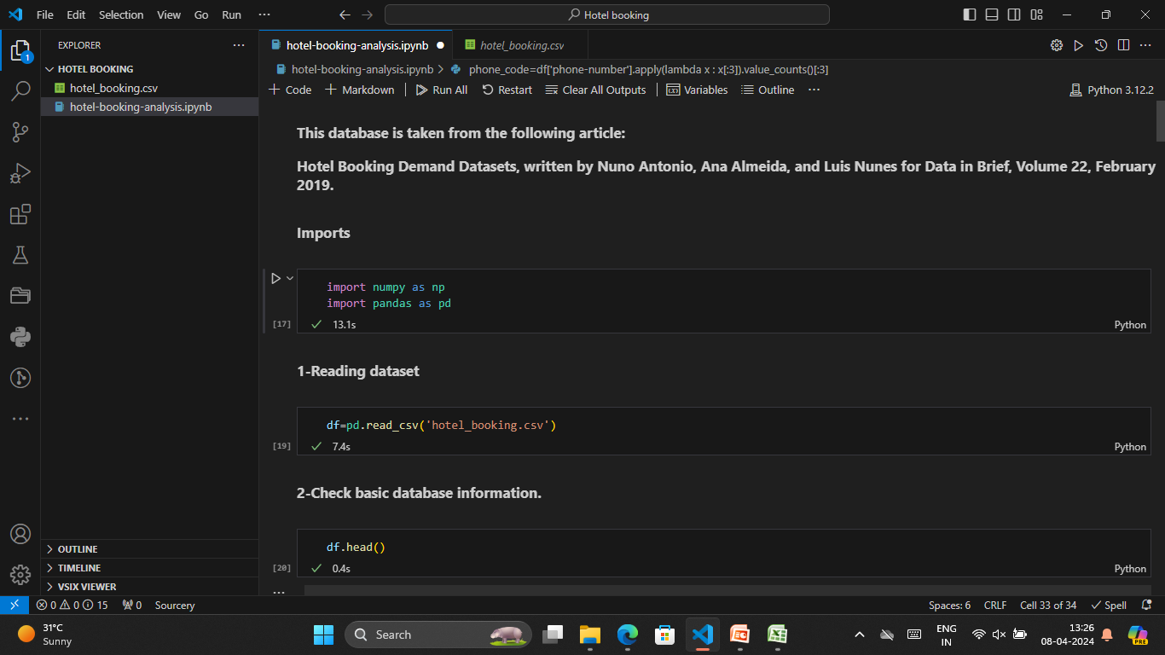
Result
Hotel booking analysis output

Slide 8
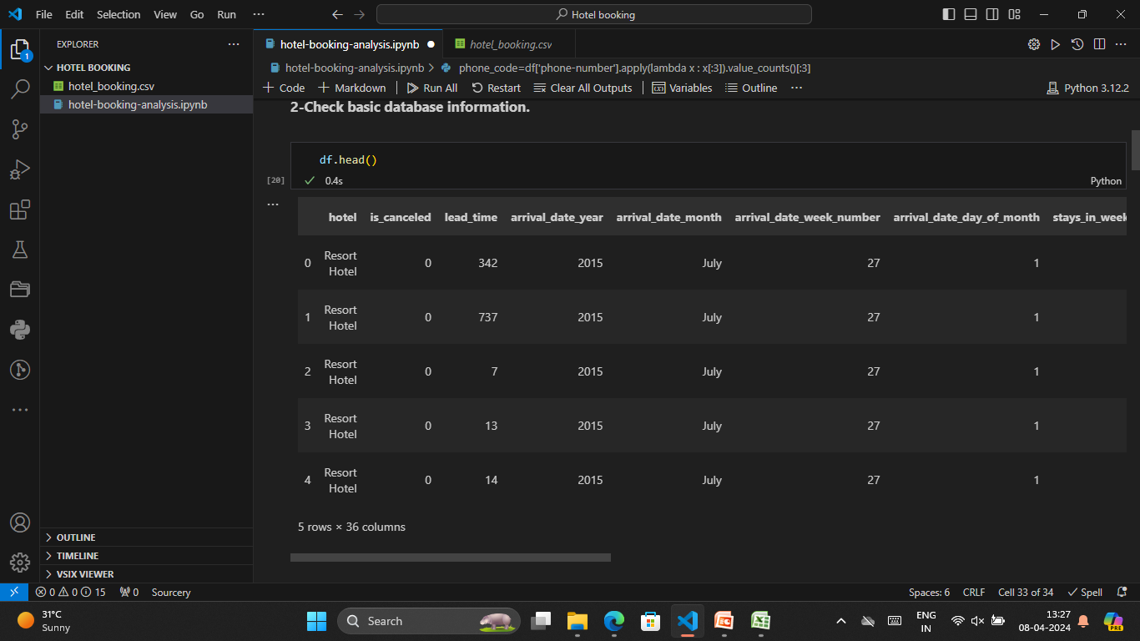

Slide 9
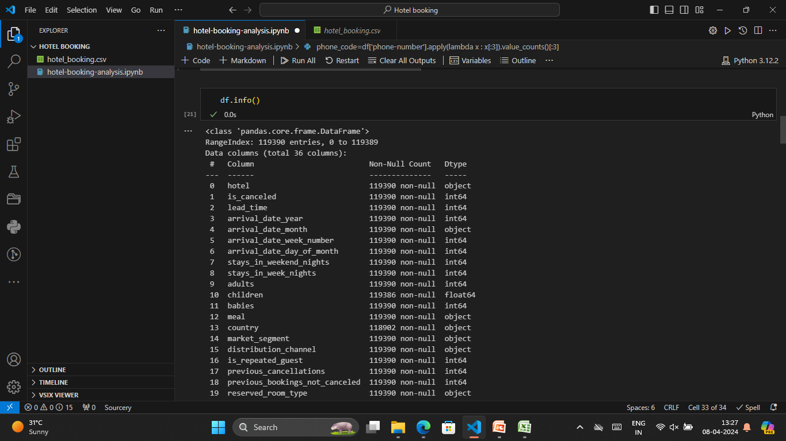
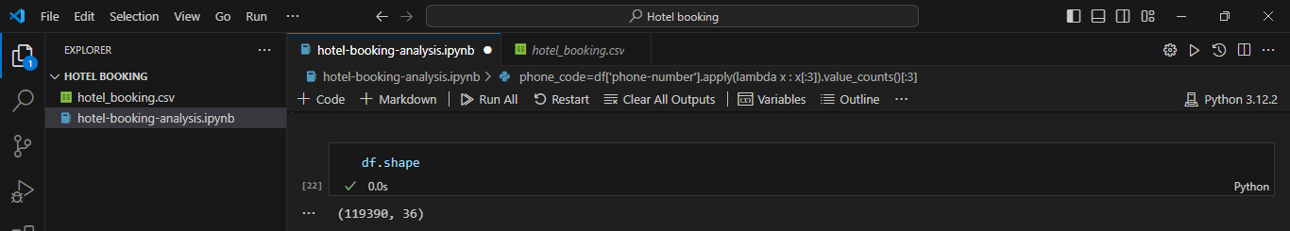

Slide 10
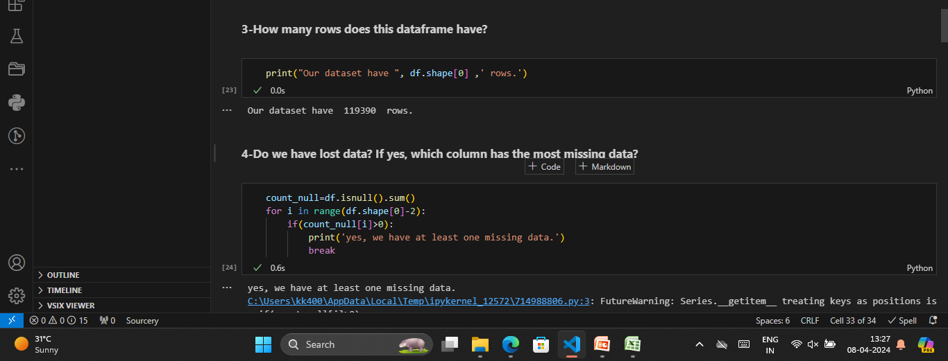
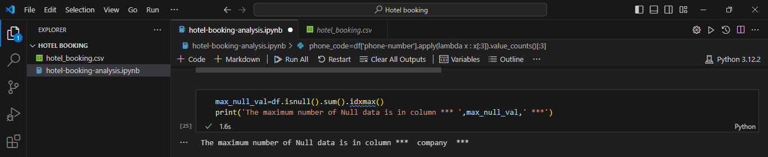

Slide 11
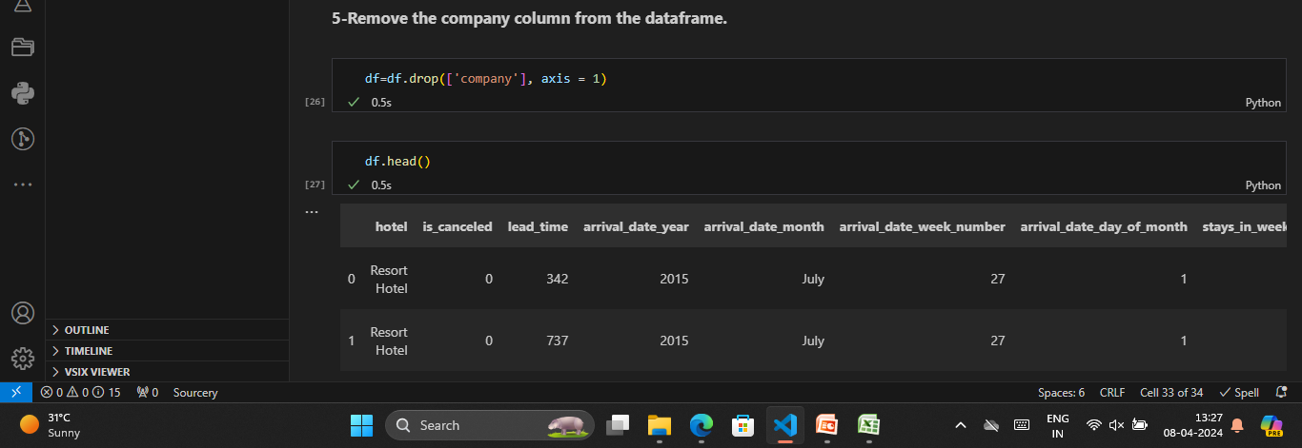

Slide 12
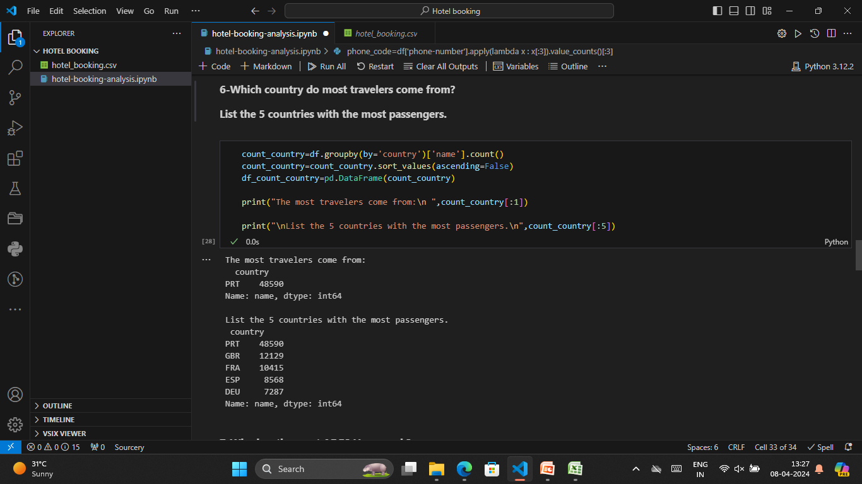

Slide 13
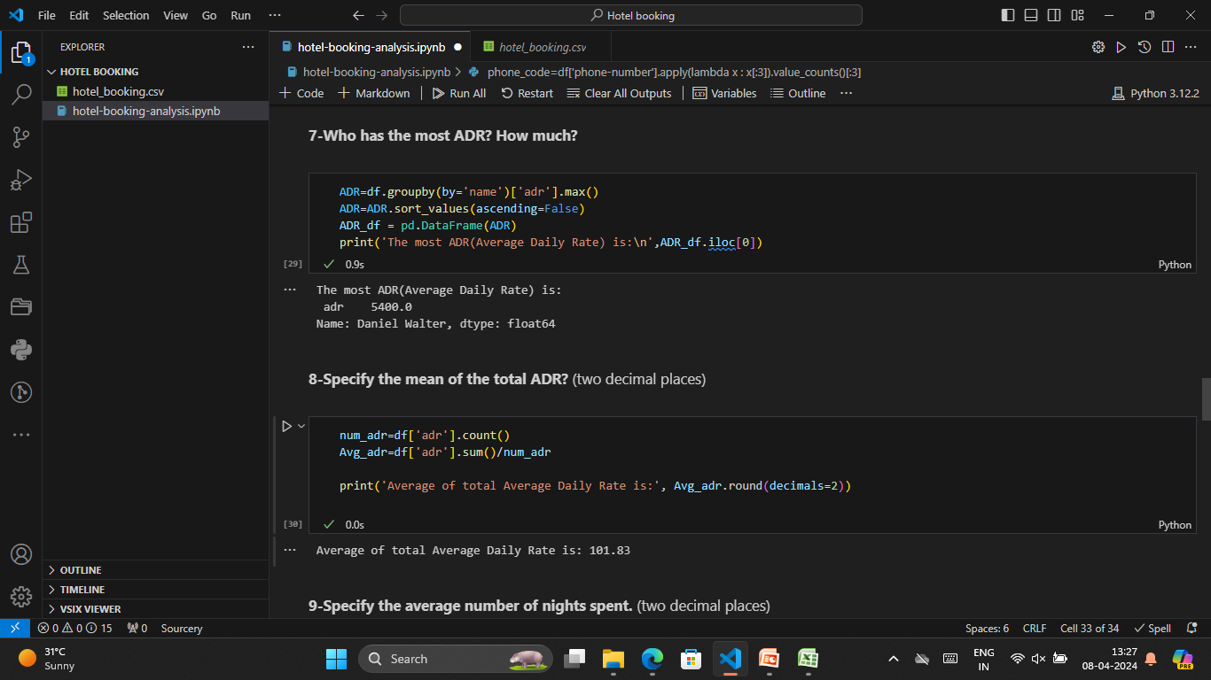

Slide 14
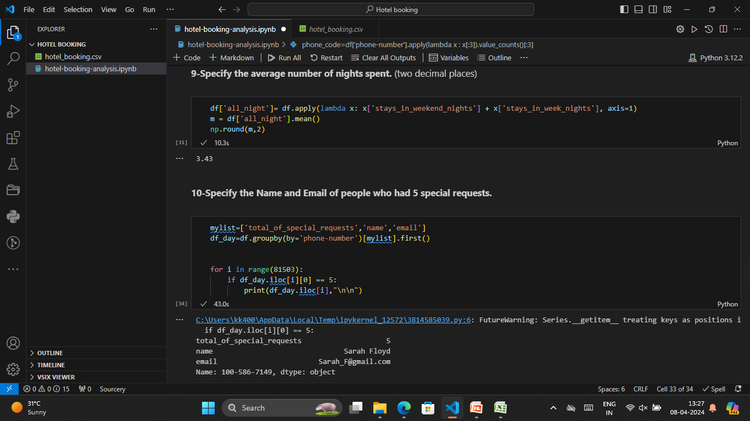

Slide 15
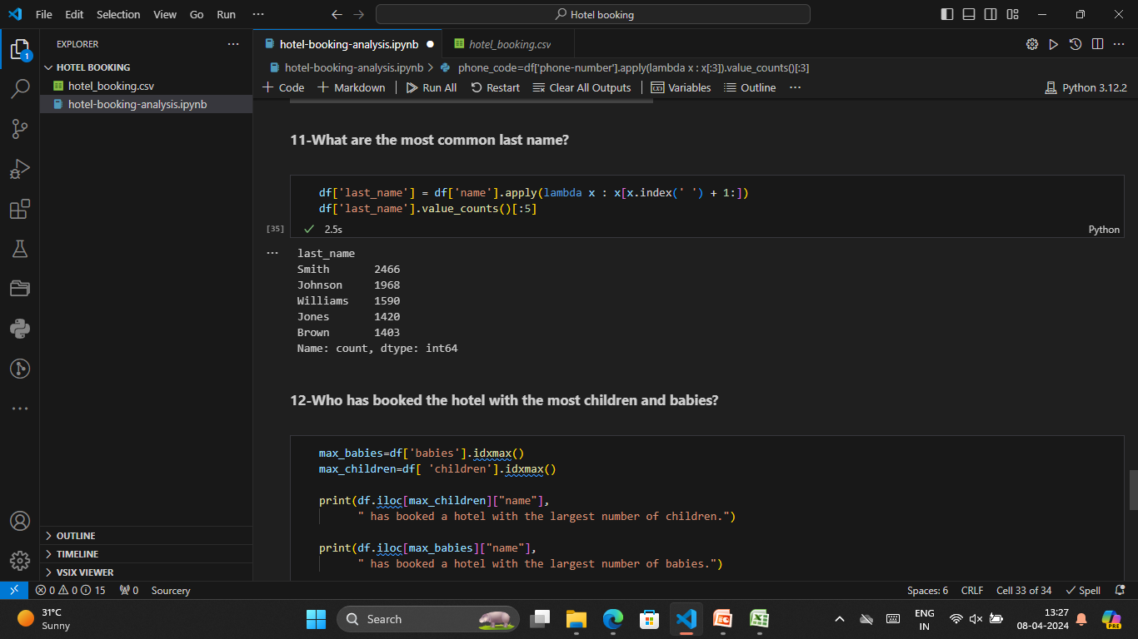

Slide 16
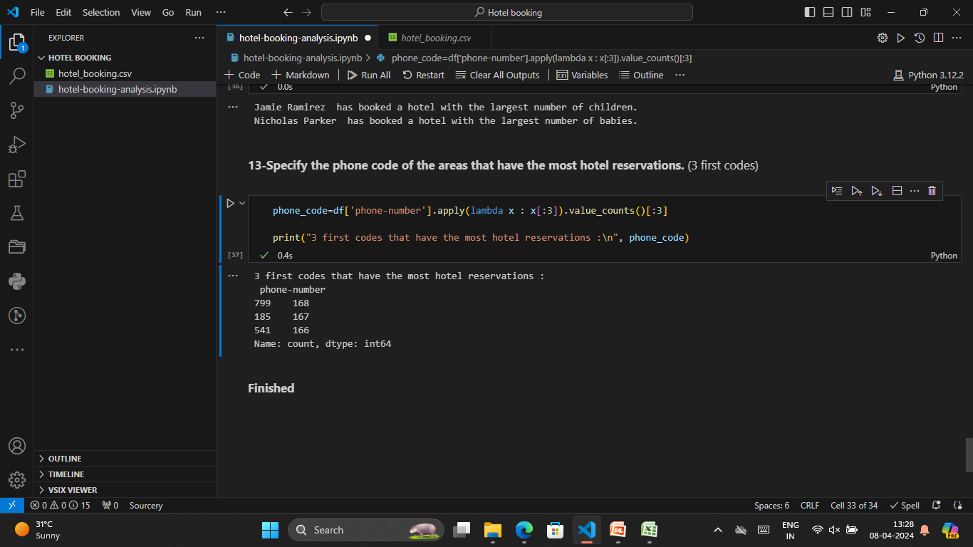

Slide 17
Conclusion
The hotel booking analysis conducted provides valuable insights into booking patterns, customer behavior, and optimization strategies within the hospitality industry. Through thorough data exploration, modeling, and deployment considerations, several key findings and recommendations have been identified to enhance booking processes and improve overall business performance.
Key Findings:
Demand Forecasting
Customer Segmentation
Cancellation Prediction
Optimization Strategies
In conclusion, the hotel booking analysis serves as a valuable tool for hotel management to optimize booking processes, increase revenue, and improve customer satisfaction. By leveraging data-driven insights and implementing recommended strategies, hotels can stay competitive in the dynamic hospitality industry landscape.

Slide 18
Future scope
The future scope of hotel booking analysis encompasses a range of advancements and enhancements that can further optimize booking processes, improve customer experiences, and drive business growth within the hospitality industry. Here are some potential areas for future exploration and development:
Predictive Analytics with AI and Machine Learning
Big Data and IoT Integration
Enhanced Personalization and Customer Experience
Blockchain Technology for Security and Transparency
Augmented Reality (AR) and Virtual Reality (VR) Experiences
Sustainable and Eco-Friendly Practices
Predictive Maintenance and Asset Management
Partnerships and Collaborations

Slide 19
References
Books:
"Hotel Management and Operations" by Michael J. O'Fallon and Denney G. Rutherford
"Data Science for Business: What You Need to Know about Data Mining and Data-Analytic Thinking" by Foster Provost and Tom Fawcett
"Predictive Analytics for Dummies" by Anasse Bari, Mohamed Chaouchi, and Tommy Jung
Cornell Hospitality QuarterlyAcademic Journals:
Journal of Hospitality and Tourism Research
International Journal of Contemporary Hospitality Management
Online Courses and Tutorials:
Coursera: Data Science and Machine Learning courses
Udemy: Hospitality Management courses
DataCamp: Data Science and Predictive Analytics courses
Industry Reports and Whitepapers:
Reports from hospitality industry research firms such as STR, CBRE Hotels, and Deloitte
Websites and Blogs:
HospitalityNet
Skift
HotelTechReport

Slide 20
THANK YOU

